Slide 1
Computational Thermal Engineering
Solving Convection Equation in OpenFOAM
DAY 9
Kumaresh Selvakumar

Slide 2
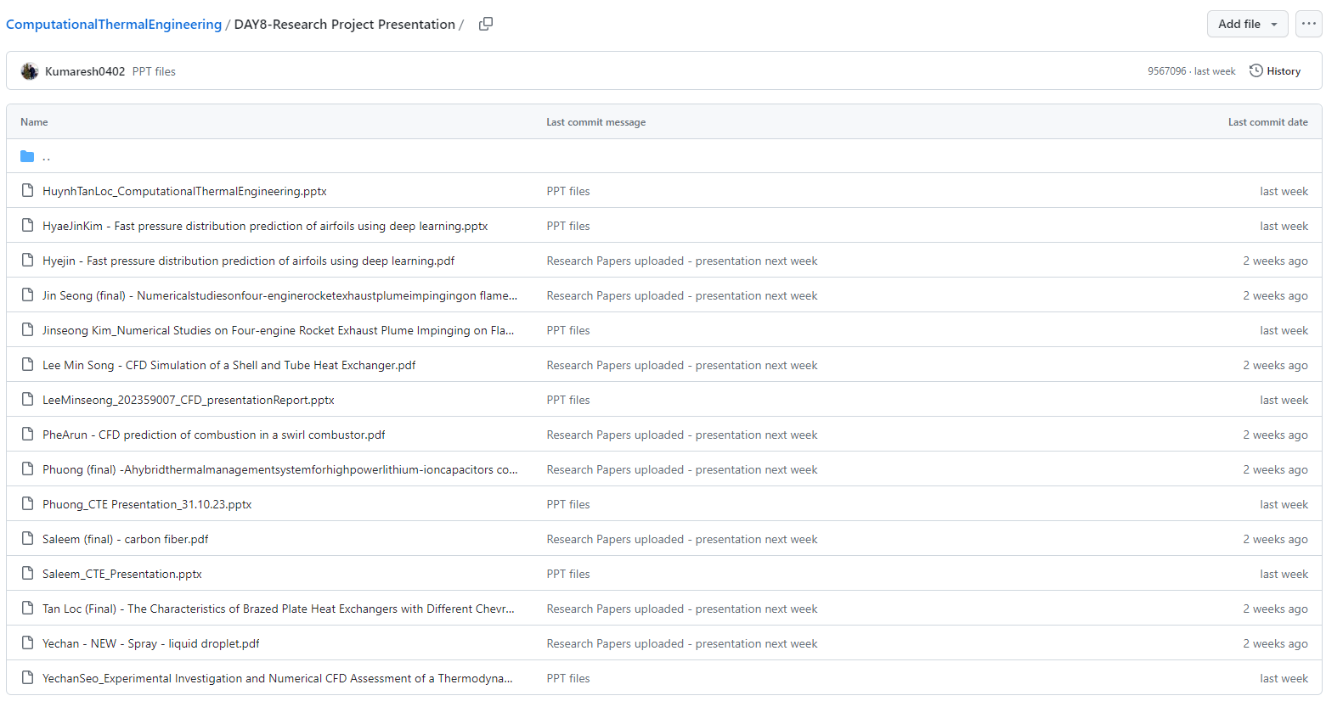
Quick Recap – Research Paper Presentation
Notes:
https://ezgif.com/maker
Dirichlet boundary conditions assume the solution to the variable.
In Neumann boundary conditions, a solution is assumed for the derivative of the variable.
https://en.wikipedia.org/wiki/Von_Neumann_stability_analysis

Slide 3
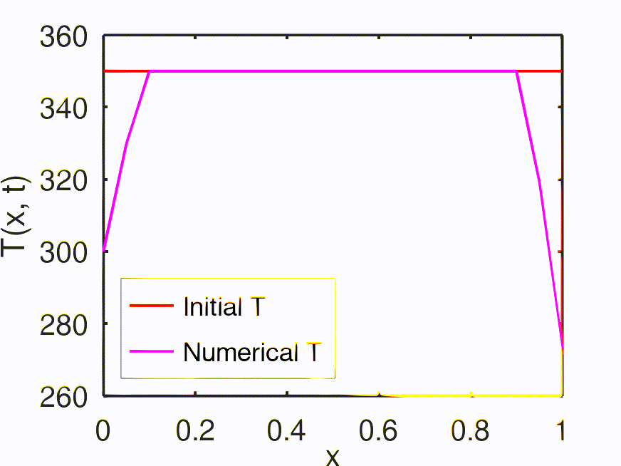
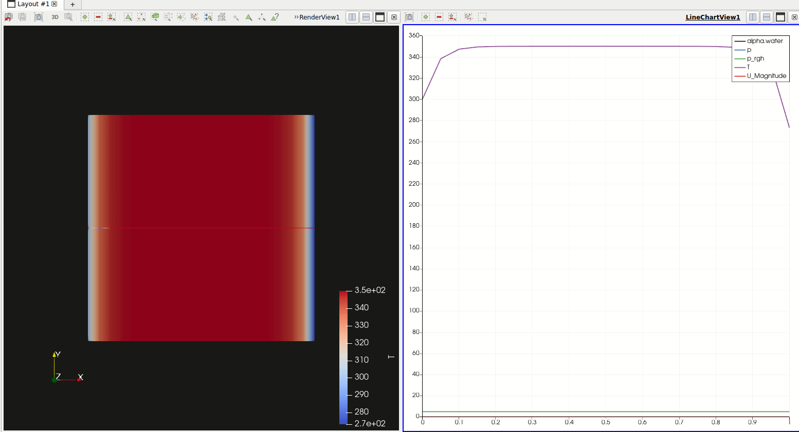
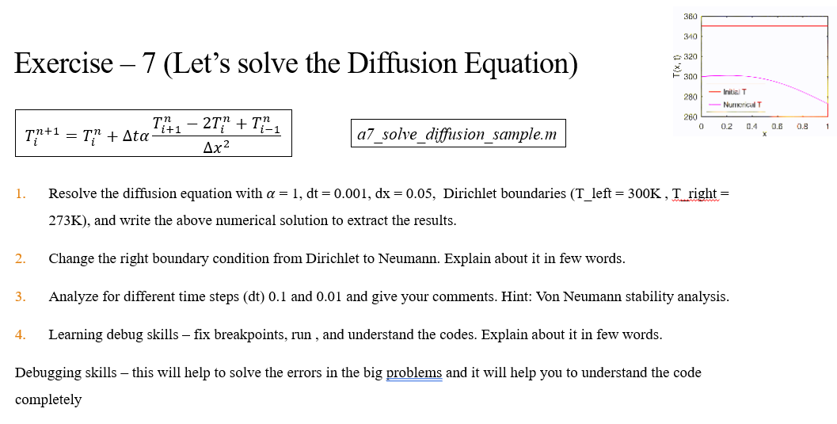
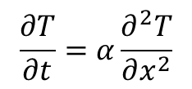
Quick Recap – Diffusion equation
$$\frac{∂T}{∂t}=α\frac{∂^{2}T}{∂x^{2}}$$
Octave → exercise – 7
OpenFOAM → Project – 1

Slide 4
Contents – DAY 9
Run OpenFOAM: Numerical Solution to Diffusion Equation (Project – 1)
Explanation about Convection equation
Run OpenFOAM: Numerical Solution to Convection Equation (Project – 2)

Slide 6
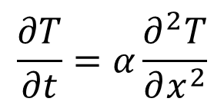
OpenFOAM: Numerical Solution to Diffusion Equation
Paraview – Post Processing tool in OpenFOAM
$$\frac{∂T}{∂t}=α\frac{∂^{2}T}{∂x^{2}}$$

Slide 7
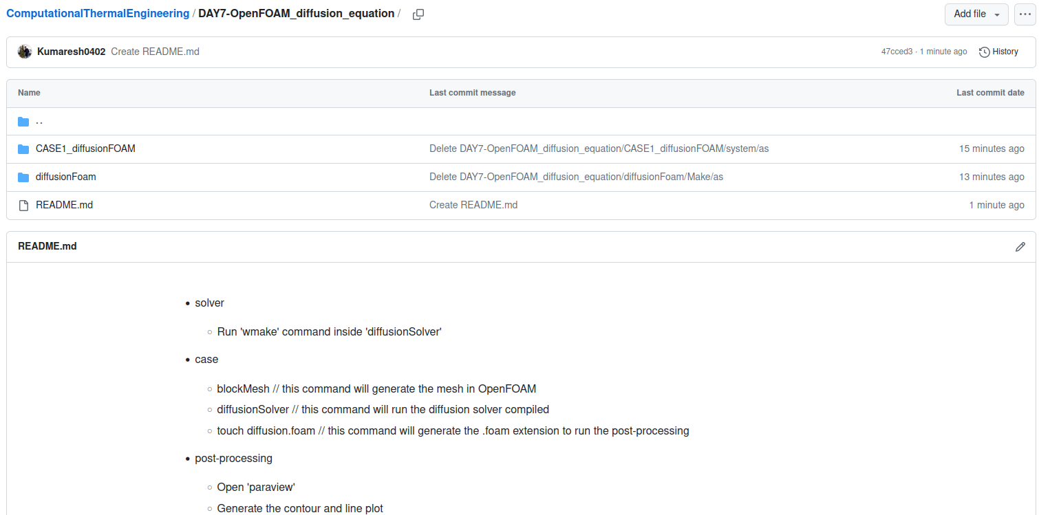
Extract files from GitHub

Slide 8
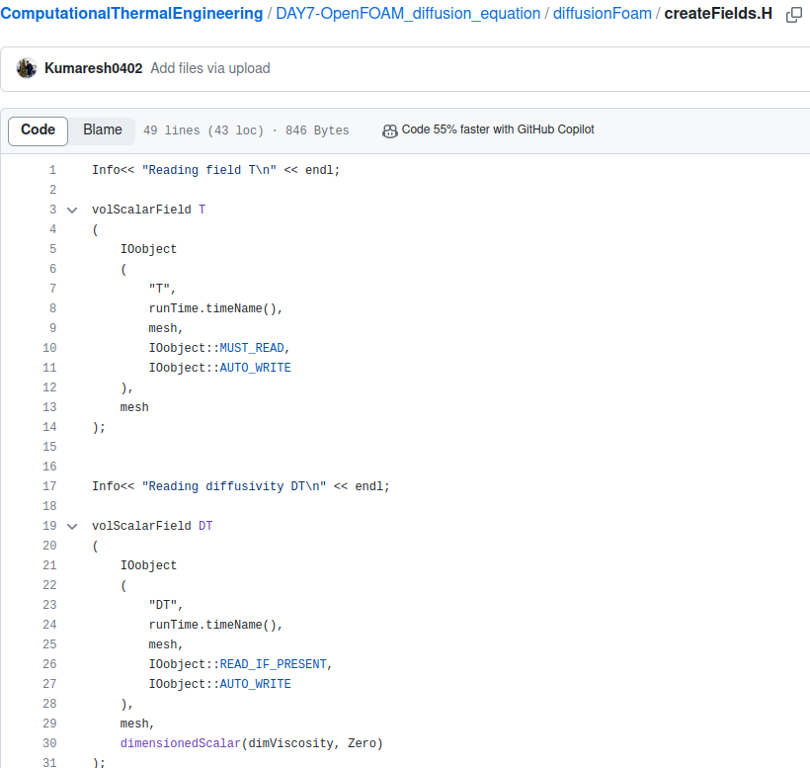
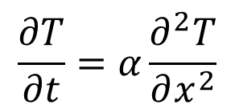
solver file ➔ diffusionFoam/createFields.H
$$\frac{∂T}{∂t}=α\frac{∂^{2}T}{∂x^{2}}$$
Temperature “T” field is created
Diffusivity as a field created

Slide 9
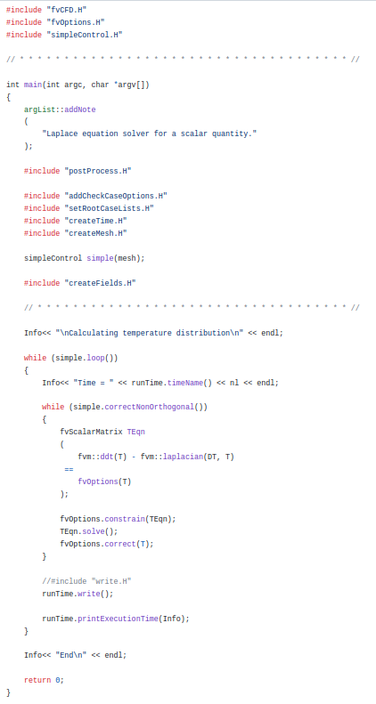
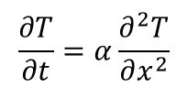
solver file ➔ diffusionFoam/diffusionFoam.C
Necessary “header” files
Matrix is created to solve “FVM”
$$\frac{∂T}{∂t}=α\frac{∂^{2}T}{∂x^{2}}$$

Slide 10
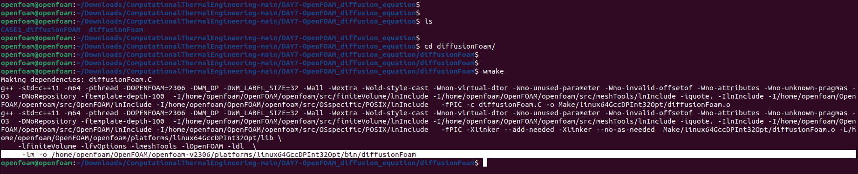
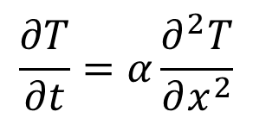
Compile diffusionFoam “solver”
$$\frac{∂T}{∂t}=α\frac{∂^{2}T}{∂x^{2}}$$
Compiled “diffusionFoam“ solver

Slide 11
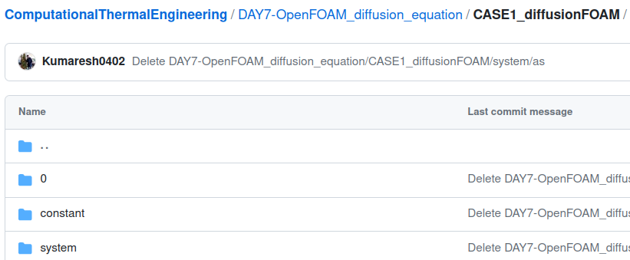
case file
$$\frac{∂T}{∂t}=α\frac{∂^{2}T}{∂x^{2}}$$
Initial conditions
Properties
Mesh, schemes, solvers, algorithm controls and tolerances for the implicit solvers.

Slide 12
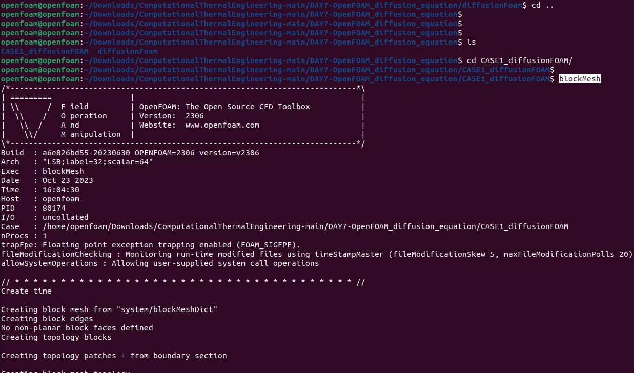
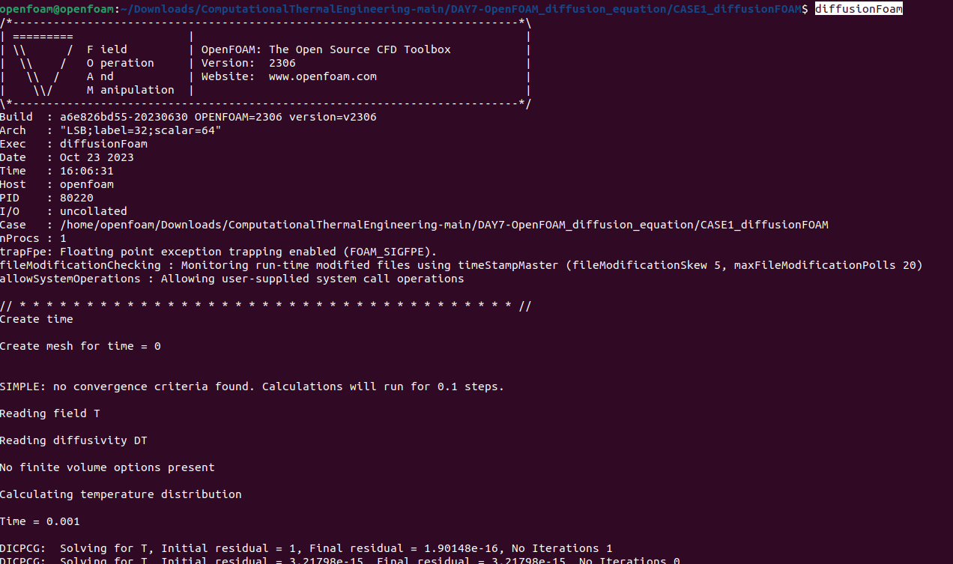
Compile the “case” file named – CASE1_diffusionFOAM
2
1

Slide 13
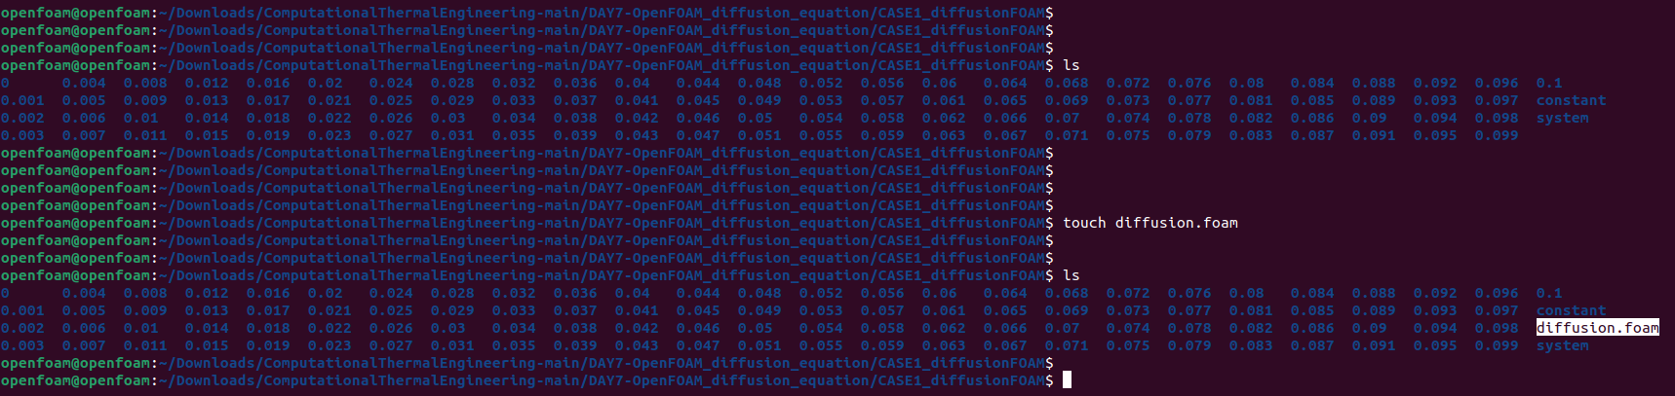
Compile the “case” file named – CASE1_diffusionFOAM
3

Slide 14
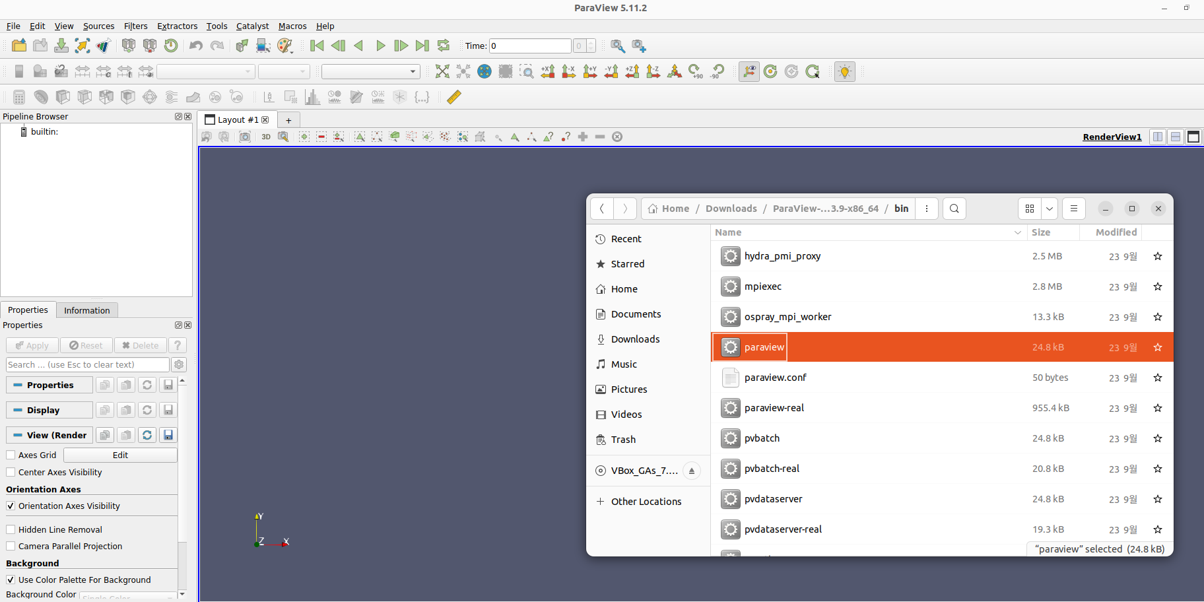
Open “Paraview”
Used for post-processing your results

Slide 15
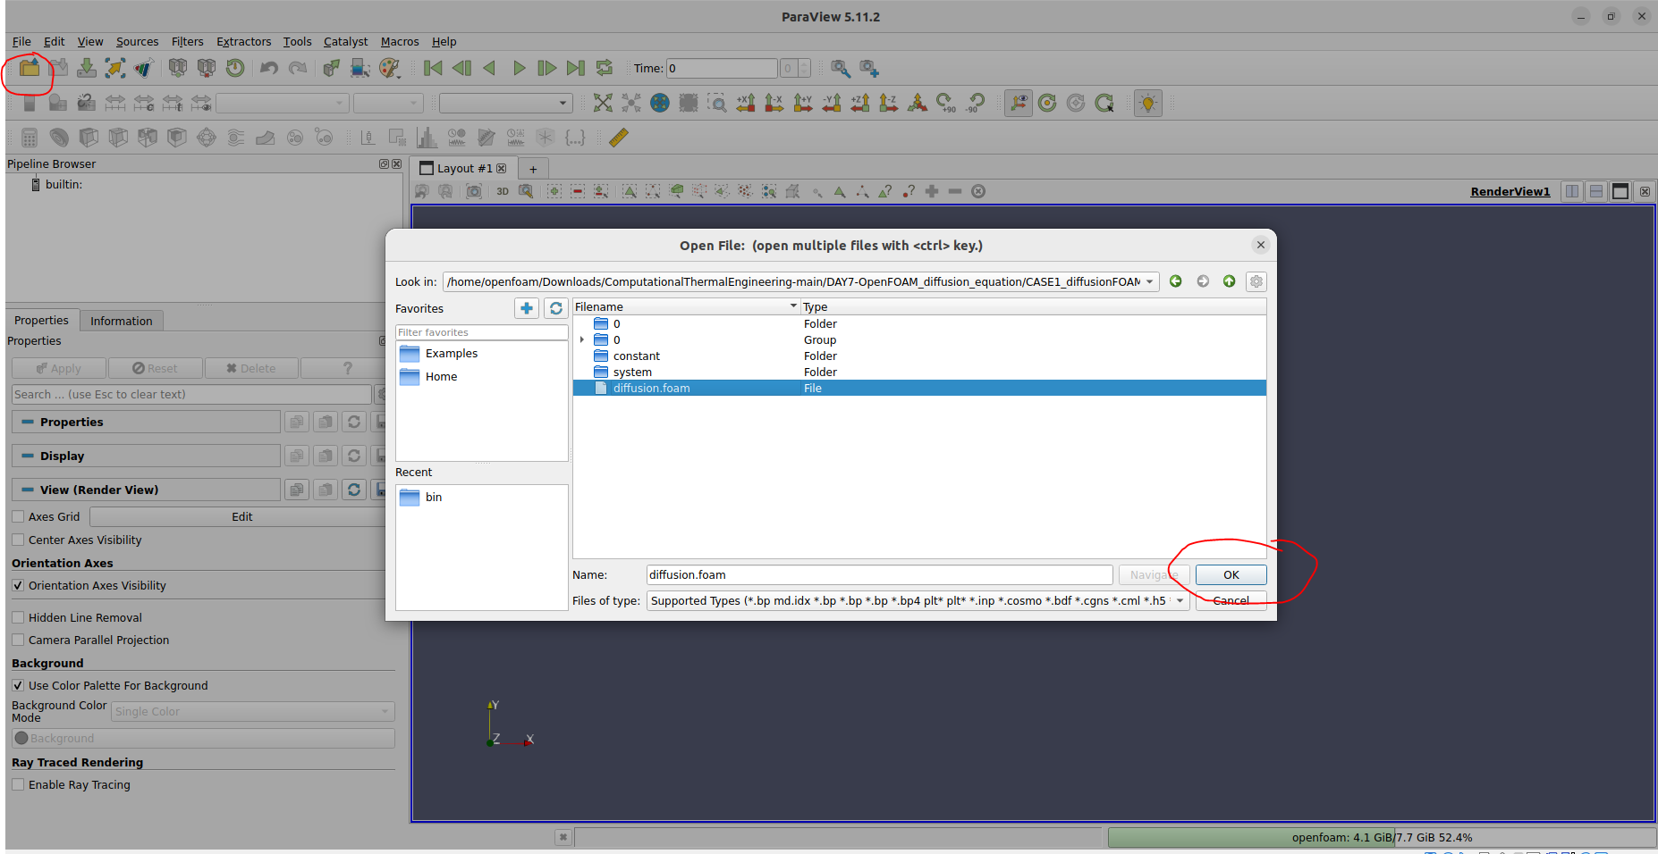
Open the “case” in paraview
4

Slide 16
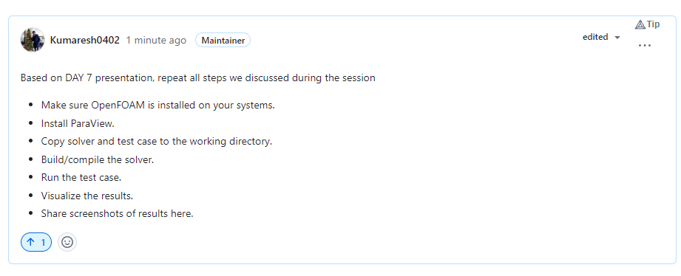
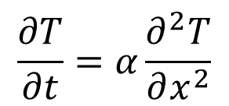
Project – 1 (Diffusion Equation using OpenFOAM)
$$\frac{∂T}{∂t}=α\frac{∂^{2}T}{∂x^{2}}$$

Slide 18
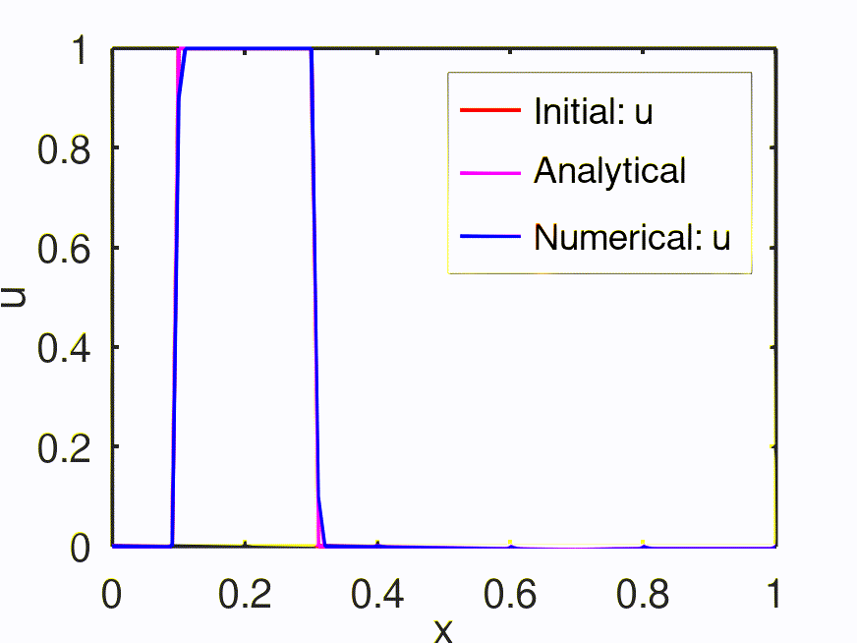
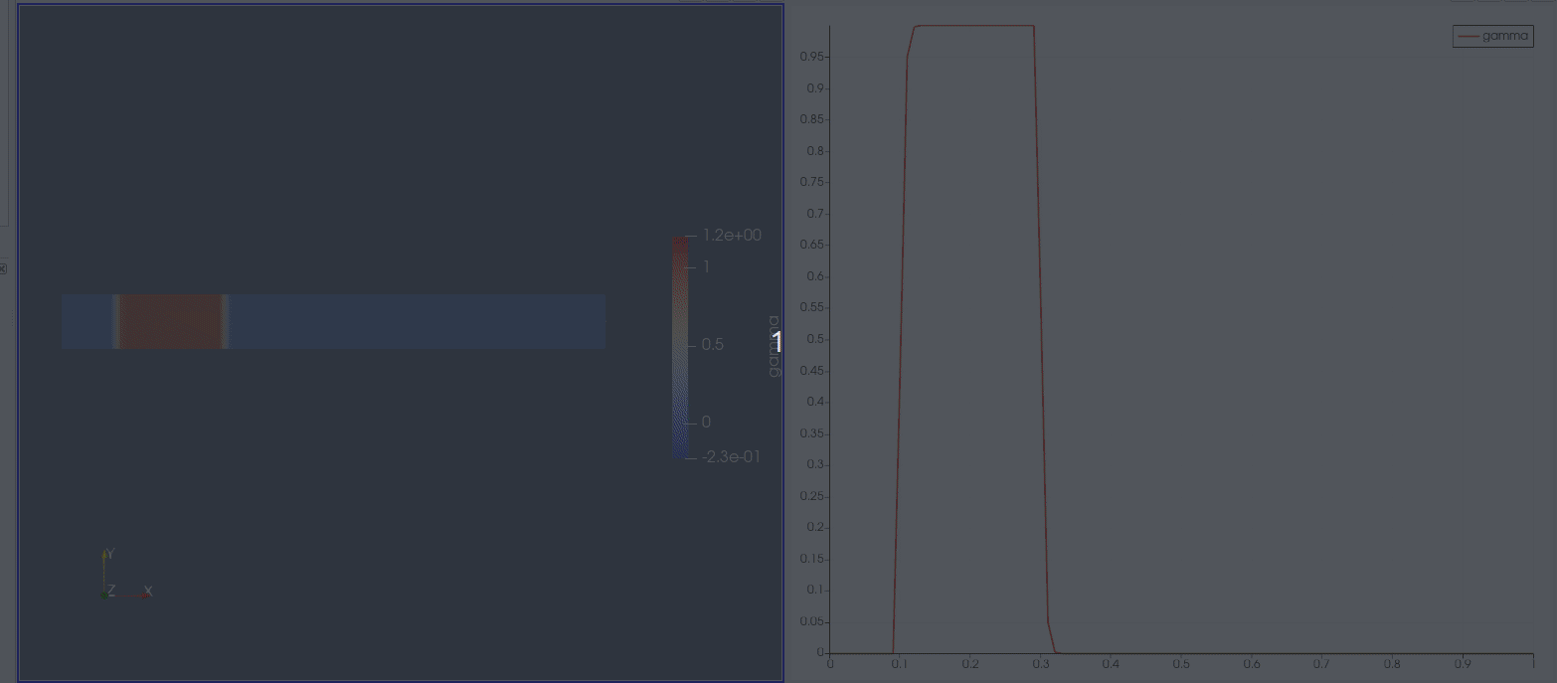
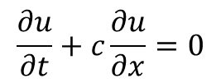
OpenFOAM: Numerical Solution to Convection Equation
$$\frac{∂u}{∂t}+c\frac{∂u}{∂x}=0$$

Slide 19
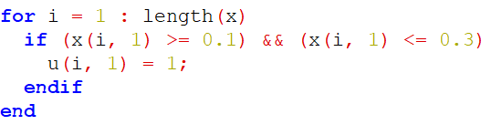
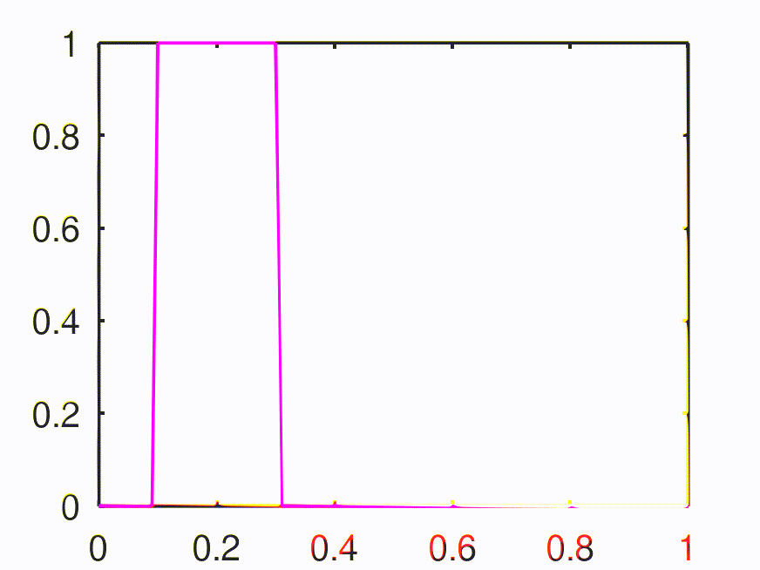
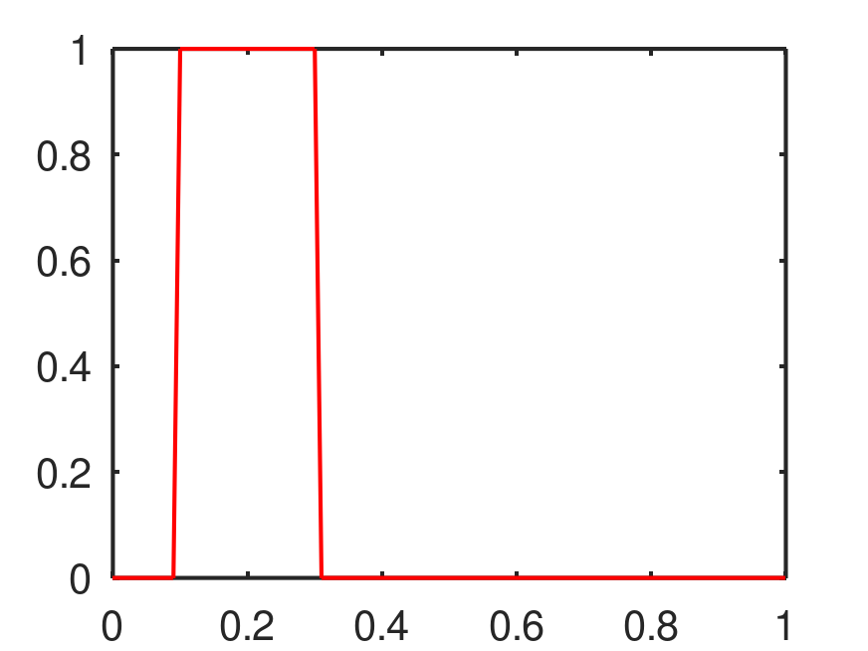
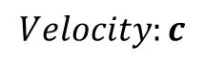
Convection Equation
Setting initial field
$$Velocity:c$$

Slide 20
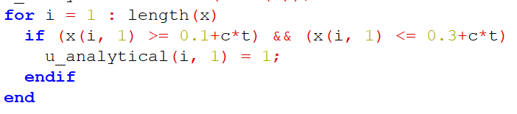
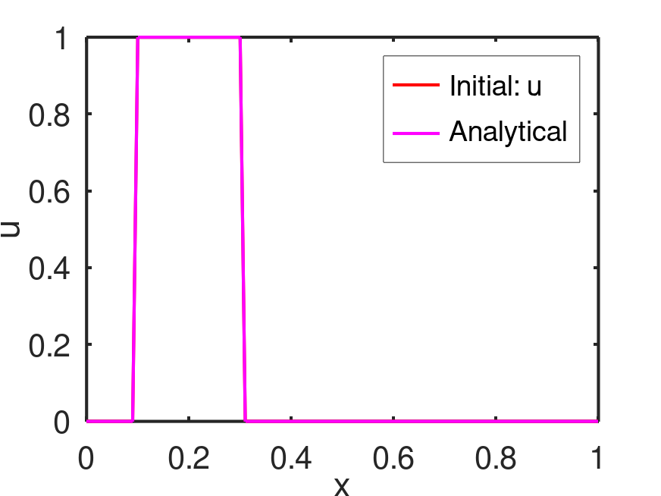
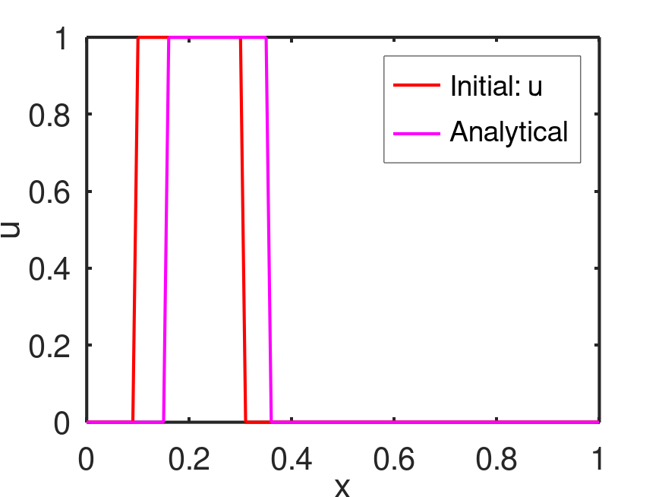
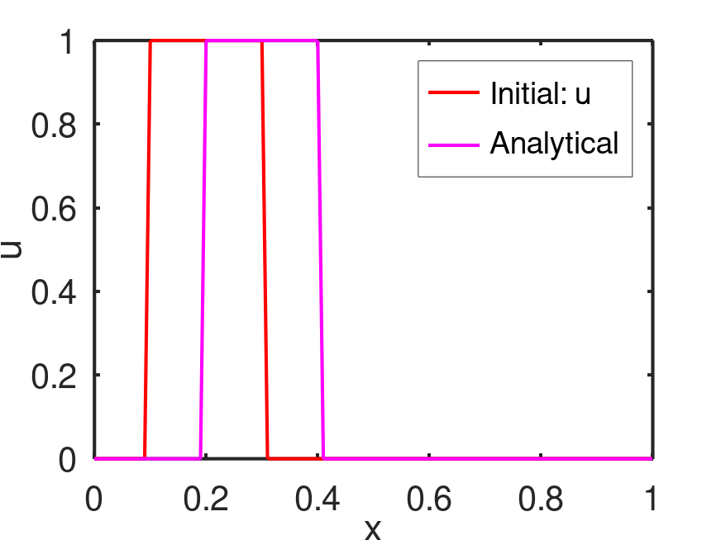
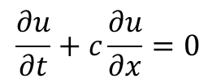
Convection Equation
$$\frac{∂u}{∂t}+c\frac{∂u}{∂x}=0$$
Advection equation

Slide 21
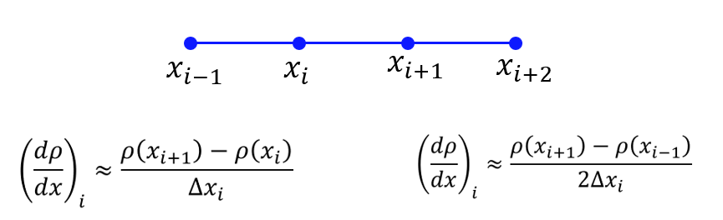
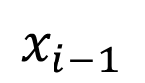
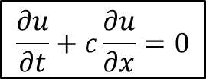
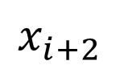
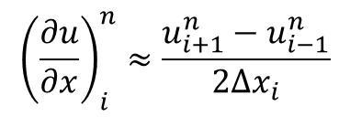
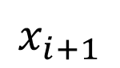
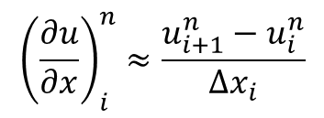
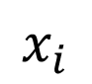
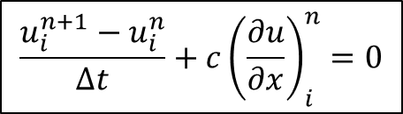
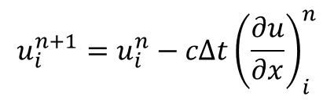
Convection Equation
$$\frac{∂u}{∂t}+c\frac{∂u}{∂x}=0$$
$$\frac{u_{i}^{n+1}−u_{i}^{n}}{Δt}+c{\left(\frac{∂u}{∂x}\right)}_{i}^{n}=0$$
$$x_{i−1}$$
$$x_{i}$$
$$x_{i+1}$$
$$x_{i+2}$$
$${\left(\frac{∂u}{∂x}\right)}_{i}^{n}≈\frac{u_{i+1}^{n}−u_{i}^{n}}{Δx_{i}}$$
Simple forward
difference scheme
$$u_{i}^{n+1}=u_{i}^{n}−cΔt{\left(\frac{∂u}{∂x}\right)}_{i}^{n}$$
$${\left(\frac{∂u}{∂x}\right)}_{i}^{n}≈\frac{u_{i+1}^{n}−u_{i−1}^{n}}{2Δx_{i}}$$
Central difference
(Explicit) First order - Forward Euler
(only one unknown (n+1) with other knowns at n^{th} node) → conditionally stable

Slide 22
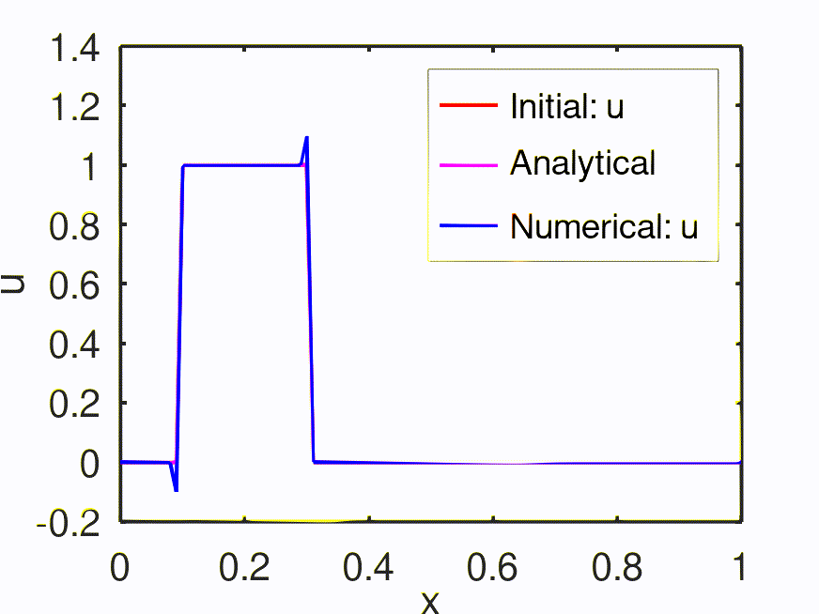
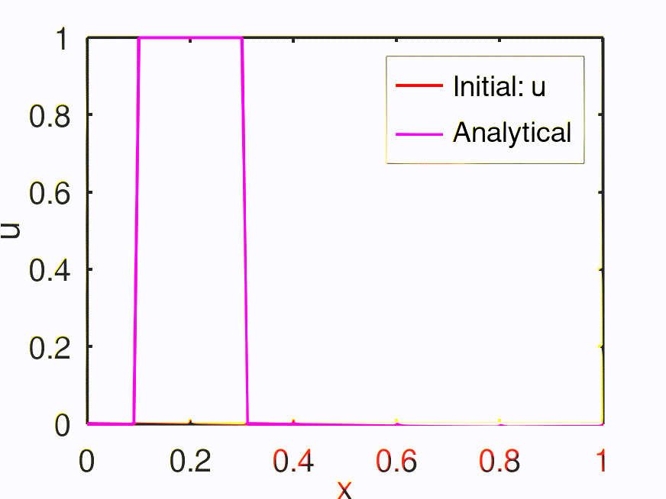
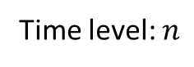
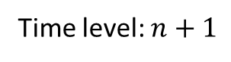
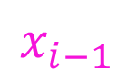
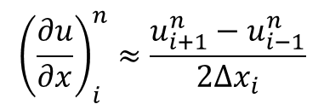
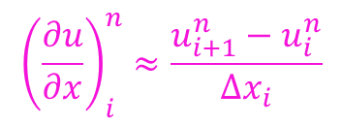




Convection Equation
Time level: $n+1$
$$x_{i−1}$$
$$x_{i}$$
$$x_{i+1}$$
$$x_{i+2}$$
Time level: $n$
$$x_{i+1}$$
$$x_{i+2}$$
$$x_{i−1}$$
$$x_{i}$$
Information from right to left end
$${\left(\frac{∂u}{∂x}\right)}_{i}^{n}≈\frac{u_{i+1}^{n}−u_{i}^{n}}{Δx_{i}}$$
Simple forward
difference scheme
$$u_{i}^{n+1}=u_{i}^{n}−cΔt{\left(\frac{∂u}{∂x}\right)}_{i}^{n}$$
$${\left(\frac{∂u}{∂x}\right)}_{i}^{n}≈\frac{u_{i+1}^{n}−u_{i−1}^{n}}{2Δx_{i}}$$
Central difference

Slide 23




Convection Equation
Time level: $n+1$
$$x_{i−1}$$
$$x_{i}$$
$$x_{i+1}$$
$$x_{i+2}$$
Time level: $n$
$$x_{i+1}$$
$$x_{i+2}$$
$$x_{i−1}$$
$$x_{i}$$
Information from left and right ends
$${\left(\frac{∂u}{∂x}\right)}_{i}^{n}≈\frac{u_{i+1}^{n}−u_{i}^{n}}{Δx_{i}}$$
Simple forward
difference scheme
$$u_{i}^{n+1}=u_{i}^{n}−cΔt{\left(\frac{∂u}{∂x}\right)}_{i}^{n}$$
$${\left(\frac{∂u}{∂x}\right)}_{i}^{n}≈\frac{u_{i+1}^{n}−u_{i−1}^{n}}{2Δx_{i}}$$
Central difference

Slide 24




Convection Equation
Time level: $n+1$
$$x_{i−1}$$
$$x_{i}$$
$$x_{i+1}$$
$$x_{i+2}$$
Time level: $n$
$$x_{i+1}$$
$$x_{i+2}$$
$$x_{i−1}$$
$$x_{i}$$
Information from left to right end
Wind is flowing from left end (bird moves from left to right)
$$u_{i}^{n+1}=u_{i}^{n}−cΔt{\left(\frac{∂u}{∂x}\right)}_{i}^{n}$$
$${\left(\frac{∂u}{∂x}\right)}_{i}^{n}≈\frac{u_{i}^{n}−u_{i−1}^{n}}{Δx_{i}}$$
Simple backward
difference scheme
$$CFL: \frac{cΔt}{Δx}$$
CFL < 1 → Numerically stable (conditionally stable based on the condition imposed by CFL) – EXPLICIT method
CFL > = 1 → Numerically unstable
CFL = 0.1

Slide 25


Project – 2 (Convection Equation using OpenFOAM)
$$\frac{∂u}{∂t}+c\frac{∂u}{∂x}=0$$

